Slide 1

Johnson Yard Service
Application Integrations
CPT-264
Group 2:
Taylor Bailey & Kelly Waldrep
01 Dec 2018

Slide 2
Table of Contents
Slide 3 – Business Report
Slide 4 – Organization Chart
Slide 5 – Request for Information Services
Slides 6-7 – Analyst Conclusions
Slides 8-9 – Project Definition
Slide 10 – Project Milestones
Slide 11 – GANTT Chart
Slide 12 – Cost Benefit Analysis & ROI
Slide 13 – Context Diagram
Slide 14 – Data Flow Diagram 0
Slides 15-22 – Data Dictionary
Slide 23 – Requirements & Benefits
Slides 24-35 – System Design Components
Slide 36 – Alternative Recommendation
Slide 37 - Summary

Slide 3
Business Report
Family-Owned Small Business
Experiencing Growth
Provides Landscaping Services
Fifty+ Regular Customers
25-30 Special Project Customers
$250,000 - $280,000 Annual Revenue

Slide 4
Organization Chart
Kyle Johnson Owner/Team Lead
Jon O. Marketing & Business Consultant
Davis J. Team Lead
Matt J. Marketing & Business-building Consultant
Joseph B. Team Member
Rives M. Team Member

Slide 5
Request for Information Services
REQUEST FOR INFORMATION SERVICES
Date: 11/5/2018
System enhancement: Yes | Title: Multiple QuickBooks Integrations
Department: Operations | Location: 131 E Richardson Ave Suite B, Summerville, SC 29483
New system: No | E-mail: kjohnson.service@gmail.com
REQUEST FOR: | URGENCY:
[ ] Correction of system error | [ ] Immediate attention required
[X] System enhancement | [X] Handle in normal priority sequence
[ ] New system | [ ] Defer until new system is developed
DESCRIPTION OF REQUESTED SYSTEMS SERVICES: (ATTACH ADDITIONAL DOCUMENTS AS NECESSARY)
Research and identify plugins, APIs, or extensions to be integrated with QuickBooks Online financial management package that will streamline client workflow and eliminate as many manual data entry points as possible. Client currently expends a great deal of labor hours manually completing “bookkeeping” type tasks and manually entering that information into financial management software. Ideally system enhancements should be optimized for smart phone data input and viewing due to nature of business and mobile workforce. Consideration should be given to automation of any task that can be automated, such as work logs and time tracking, utilizing GPS or similar technologies. Client Requested Integrations: Customer Information (CRM) Work Log and Detailed Time Tracking Employee Timecards (w/employee portal) Employee Payroll (w/employee portal) Equipment Maintenance and Scheduling Routing and Scheduling Platform to document company policies and processes
(To be completed by the Information Technology Department)
[X] Approved | Assigned to IT contact person: Taylor Bailey, Kelly Waldrep, Ryan Levi
[ ] Modified (see attached notes) | User: Kyle Johnson
[ ] Rejected (see attached notes) | Urgency code (1 low to 5 high): 3
Date: 11/5/2018 | Action: Research QuickBooks integrations, determine timeline, determine client budget

Slide 6
Analyst Conclusions
Continue use of QuickBooks Online
Implement Homebase Enterprise Integration
Mobile Platform
Automates Tasks
Scheduling
Timesheets
Team Communication
Implement Square/Bill & Pay Integration
Mobile Platform
Automates Tasks
Invoicing
Payment Processing
Customer Data

Slide 7
Analyst Conclusions
Expected Benefits
Data Entry Error Reduction
Improved Time Management
Improved & Documented Record of Communication
Centralized Online Scheduling System
Opportunities
Business Growth
Application Development with External Business Partners

Slide 8
Project definition
Project Title:
Johnson Yard Service QuickBooks Online Application Integrations
Problem Statement:
Johnson Yard Service requires application implementations that will integrate with QuickBooks Online to automate and digitize data processes currently completed using manual logs and forms.
Project Objectives:
Increase data integrity by reducing errors resulting from manual entry and lost paperwork
Improve time management by automating tasks with applications that integrate with one another
Streamline communication between the owner, team leads, field service teams, and customers
Provide a centralized online scheduling system for service
Assign job taskings to appropriate team members
Capture employee data
Hours worked
Integrate with QuickBooks Online for payroll information
Track customer information
Customer location and service history
Invoicing that integrates with QuickBooks Online for accounts receivable data
Applications offer a Mobile Platform

Slide 9
Project definition
Project Risks:
A defined budget has not been provided. This is a small, but growing family-owned business looking for cost effective solutions. Consideration must be given to subscription fees. Work should be accomplished during the slower winter work season; two-week holiday during the middle of the project.
Key Members:
Sponsor: Kyle Johnson
Project Team Leader: Kyle Johnson
Team members: Davis J.
Project Deadline: March 8, 2019
Project Budget: Undefined. Family-owned business looking for cost effective solutions. Subscription fees and labor fees be discussed in phase 3 and the project reassessed as necessary.

Slide 10
Project Milestones
PHASE 1 Define the problem:
MILESTONE DESCRIPTION(s) | TARGET COMPLETION DATE
Audit all manual forms; create data dictionary for all data the new system must capture | 11/30/18
Inventory current IT hardware, i.e. computers and mobile devices | 11/30/18
PHASE 2 Analyze the problem and plan the way forward
MILESTONE DESCRIPTION(s) | TARGET COMPLETION DATE
Compare the data dictionary to the features within the Homebase Enterprise application; look for alternative solution if it does not meet the requirements | 12/7/18
Compare the data dictionary to the features offered by Square and Bill & Pay; select the application that meets the requirements at lower cost | 12/14/18
Prepare training presentation on the new applications, the features provided, the integration with current QuickBooks Online, cost of services and devices, and transition plan | 12/31/18
Prepare final estimate for implementation setup of the new systems | 12/31/18
PHASE 3 Educate and train those affected
MILESTONE DESCRIPTION(s) | TARGET COMPLETION DATE
Meet with the owner to review the training presentation materials | 1/09/19
Approval of final estimate for setup | 1/15/19
Training session with team leads and employees; note any concerns or necessary changes | 1/23/19
PHASE 4 Implementation
MILESTONE DESCRIPTION(s) | TARGET COMPLETION DATE
Subscribe to new applications and integrate with QuickBooks Online account | 1/28/19
Enter any remaining customer and employee data | 2/5/19
Purchase any necessary hardware, mobile devices | 2/5/19
Install applications on all devices | 2/8/19
Prepare user guide for the owner, team leads, and field service employee | 2/13/19
PHASE 5 Evaluate against objectives & ensure gains are held
MILESTONE DESCRIPTION(s) | TARGET COMPLETION DATE
Week 1 follow-up; address any training issues, note discrepancies in communication or data flow, make any required changes to the user guides | Week 1 Usage 2/18/19 – 2/23/19, Follow-up no later than 2/28/18
Verify all required data is captured and flows appropriately between applications | 2/28/19
Corrections/Improvements as required | 3/8/19

Slide 11
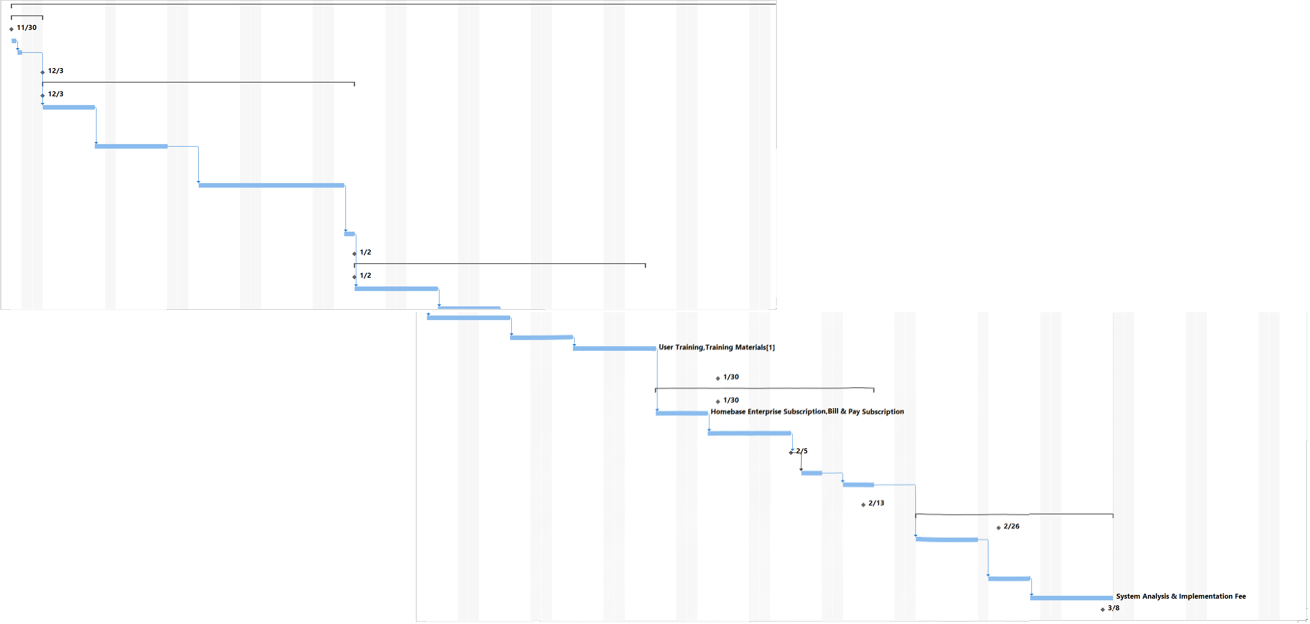
Gantt Chart

Slide 12
Cost Benefit Analysis & Return on Investment
Cost Benefit Analysis:
Year 1
Non-recurring Costs: $7,800.00
Recurring Costs: $1,427.40
Expected Benefits: $29,608.00
Return on Investment:
Begins 5/1/19
Year 1 ROI – 3.21%

Slide 13
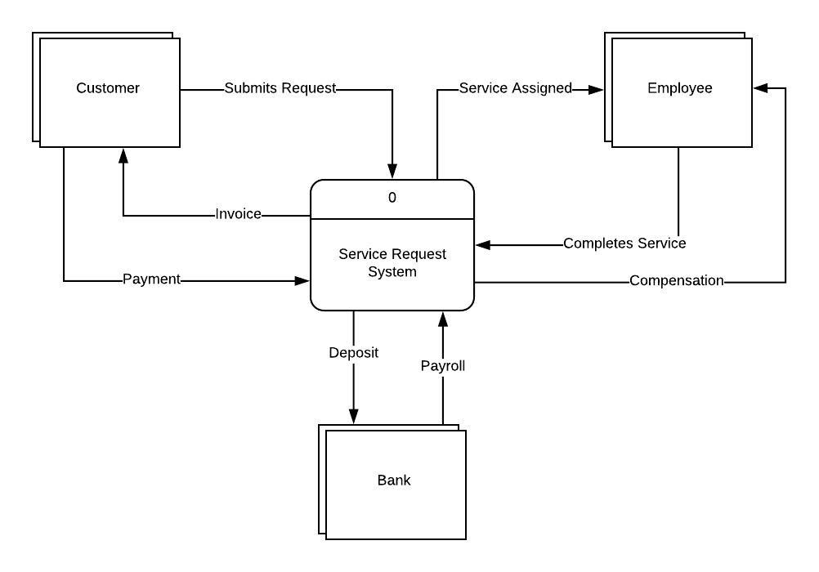
Service Request System Context Diagram

Slide 14
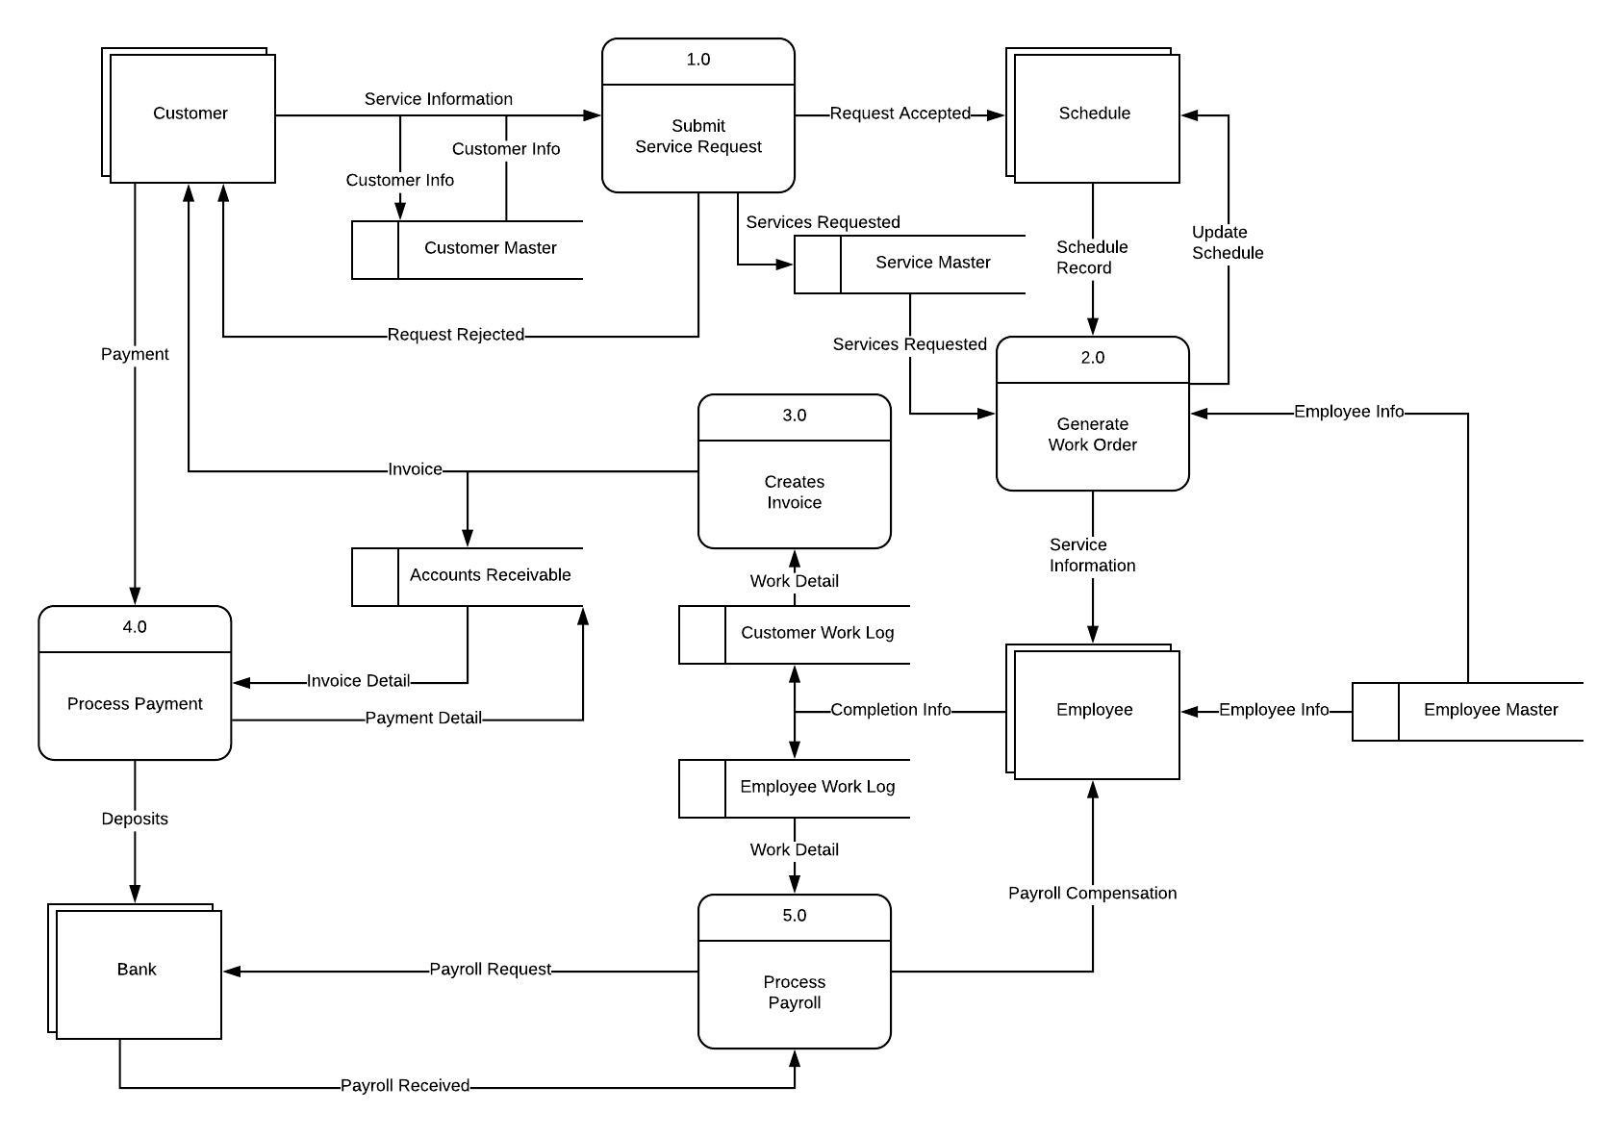
Service Request System Data Flow Diagram 0

Slide 15
Data Dictionary: Data Elements
Customer Master Database
Label: customerNumber | Type/Length: Numeric
Source: customerMaster (Quickbooks Online) | Security: Owner
 | Responsible User: Owner
Description: Auto assigned number for each customer in customerMaster database
Label: customerLastName | Type/Length: Alphabetic
Source: customerMaster (Quickbooks Online) | Security: Owner
 | Responsible User: Owner
Description: Provided by owner to customerMaster database
Label: customerFirstName | Type/Length: Alphabetic
Source: customerMaster (Quickbooks Online) | Security: Owner
 | Responsible User: Owner
Description: Provided by owner to customerMaster database
Label: customerStreet | Type/Length: Alphabetic
Source: customerMaster (Quickbooks Online) | Security: Owner
 | Responsible User: Owner
Description: Provided by owner to customerMaster database
Label: customerCity | Type/Length: Alphabetic
Source: customerMaster(Quickbooks Online) | Security: Owner
 | Responsible User: Owner
Description: Provided by owner to customerMaster database
Label: customerState | Type/Length: Alphabetic
Source: customerMaster (Quickbooks Online) | Security: Owner
 | Responsible User: Owner
Description: Provided by owner to customerMaster database

Slide 16
Data Dictionary: Data Elements
Customer Master Database (continued)
Employee Master Database
Label: customerZipCode | Type/Length: numeric
Source: customerMaster (Quickbooks Online) | Security: Owner
 | Responsible User: Owner
Description: Provided by owner to customerMaster database
Label: customerLastName | Type/Length: Alphabetic
Source: customerMaster (Quickbooks Online) | Security: Owner
 | Responsible User: Owner
Description: Provided by owner to customerMaster database
Label: employeeNumber | Type/Length: Numeric
Source: employeeMaster (Quickbooks Online) | Security: Owner
 | Responsible User: Owner
Description: Social Security number of each employee
Label: employeeLastName | Type/Length: Alphabetic
Source: employeeMaster (Quickbooks Online) | Security: Owner
 | Responsible User: Owner
Description: Provided by owner to employeeMaster database
Label: employeeFirstName | Type/Length: Alphabetic
Source: employeeMaster (Quickbooks Online) | Security: Owner
 | Responsible User: Owner
Description: Provided by owner to employeeMaster database

Slide 17
Data Dictionary: Data Elements
Employee Master Database (continued)
Service Master Database
Label: employeeStreet | Type/Length: Alphabetic
Source: employeeMaster (Quickbooks Online) | Security: Owner
 | Responsible User: Owner
Description: Provided by owner to employeeMaster database
Label: employeeCity | Type/Length: Alphabetic
Source: employeeMaster (Quickbooks Online) | Security: Owner
 | Responsible User: Owner
Description: Provided by owner to employeeMaster database
Label: employeeZipCode | Type/Length: numeric
Source: employeeMaster (Quickbooks Online) | Security: Owner
 | Responsible User: Owner
Description: Provided by owner to employeeMaster database
Label: employeeHourlyRate | Type/Length: Numeric
Source: employeeMaster (Quickbooks Online) | Security: Owner
 | Responsible User: Owner
Description: Provided by owner to employeeMaster database
Label: serviceNumber | Type/Length: Numeric
Source: serviceMaster (Homebase Enterprise) | Security: Owner
 | Responsible User: Owner
Description: Each job type is given an auto assigned number by the database

Slide 18
Data Dictionary: Data Elements
Service Master Database (continued)
Employee Work Log Database
Label: serviceNumber | Type/Length: Numeric
Source: serviceMaster (Homebase Enterprise) | Security: Owner
 | Responsible User: Owner
Description: Each job type is given an auto assigned number by the database
Label: serviceName | Type/Length: Alphabetic
Source: serviceMaster (Homebase Enterprise) | Security: Owner
 | Responsible User: Owner
Description: Each job type is assigned a name in the database by the owner
Label: serviceRate | Type/Length: Numeric
Source: serviceMaster (Homebase Enterprise) | Security: Owner
 | Responsible User: Owner
Description: Each job type is assigned a rate by the owner
Label: serviceDate | Type/Length: Numeric
Source: employeeWorkLog (Homebase Enterprise) | Security: Owner
 | Responsible User: Owner/Team Lead/Employees
Description: Each job’s date is entered into app by the employee/team lead/owner
Label: jobNumber | Type/Length: Numeric
Source: employeeWorkLog (Homebase Enterprise) | Security: Owner
 | Responsible User: Owner/Team Lead/Employees
Description: Auto Assigned number for each job

Slide 19
Data Dictionary: Data Elements
Employee Work Log Database (continued)
Customer Work Log Database
Label: jobStartTime | Type/Length: Numeric
Source: employeeWorkLog (Homebase Enterprise) | Security: Owner
 | Responsible User: Owner/Team Lead/Employees
Description: Entered into into app by employee/team lead/owner
Label: jobEndTime | Type/Length: Numeric
Source: employeeWorkLog (Homebase Enterprise) | Security: Owner
 | Responsible User: Owner/Team Lead/Employees
Description: Entered into into app by employee/team lead/owner
Label: hoursWorked | Type/Length: Numeric
Source: employeeWorkLog (Homebase Enterprise) | Security: Owner
 | Responsible User: Owner/Team Lead/Employees
Description: calculated from the start and stop times for each job
Label: serviceName | Type/Length: Alphabetic
Source: employeeWorkLog (Homebase Enterprise) | Security: Owner
 | Responsible User: Owner/Team Lead/Employees
Description: Selected from the services offered, pulled from serviceMaster database
Label: serviceDate | Type/Length: Numeric
Source: employeeWorkLog (Homebase Enterprise) | Security: Owner
 | Responsible User: Owner
Description: Pulled from the employeeWorkLog database
Label: jobNumber | Type/Length: Numeric
Source: employeeWorkLog (Homebase Enterprise) | Security: Owner
 | Responsible User: Owner/Team Lead/Employees
Description: Pulled from the employeeWorkLog database

Slide 20
Data Dictionary: Data Elements
Customer Work Log Database (continued)
Label: serviceName | Type/Length: Alphabetic
Source: employeeWorkLog (Homebase Enterprise) | Security: Owner
 | Responsible User: Owner/Team Lead/Employees
Description: Pulled from the serviceName on the employeeWorkLog database
Label: serviceNumber | Type/Length: Numeric
Source: serviceMaster (Homebase Enterprise) | Security: Owner
 | Responsible User: Owner/Team Lead/Employees
Description: Pulled from the serviceMaster database based on the serviceName selected on employeeWorkLog
Label: serviceRate | Type/Length: Numeric
Source: serviceMaster (Homebase Enterprise) | Security: Owner
 | Responsible User: Owner/Team Lead/Employees
Description: Pulled from the serviceMaster database based on the serviceName selected on employeeWorkLog

Slide 21
Data Dictionary: Data Flows
Process Name: Submit Service Request | Process Number: 1.0
Description: Service request made by the customer. If rejected, notification is made by the owner/team lead to the customer. If accepted, the customer information and service(s) requested is entered into the scheduling system (Homebase Enterprise Application).
Process Name: Generate Work Order | Process Number: 2.0
Description: Once employee(s) are assigned for a service request by the owner, a work order generates with the employee(s) information from the employee master database and the requested service information is aligned with the service master database information. The work order updates the schedule and is provided to the employee(s). This data flow takes place within in the Homebase Enterprise Application.
Process Name: Creates Invoice | Process Number: 3.0
Description: Once the service completion information is provided by the employee within the application, the information flows to Quickbooks Online and an invoice in generated for the customer. It is generated for mailing via quickbooks, or through email/mobile device via Square or Bill & Pay.
Process Name: Process Payment | Process Number: 4.0
Description: Payments are received via check or via credit/debit through Square or Bill & Pay. Check payments are manually enter into Quickbooks Online. Deposits are sent online via Quickbooks. Square or Bill & Payment credit/debit payments are automatically processed; deposits directly into bank account and updates Quickbooks Online.
Process Name: Process Payroll | Process Number: 5.0
Description: Payroll processing runs biweekly via Quickbooks Online and employee checks are created. The payroll information is received via the Employee Work Log database maintained by Homebase Enterprise Application and automatically sends information for payroll to Quickbooks Online when requested.

Slide 22
Data Dictionary: Data Entities
Entity Name: Customer
Input: Customer Master | Output: Customer Master, Processes 1.0, 2.0, 3.0, 4.0, Schedule, Customer Work Log, and Accounts Receivable
Description: Customer data is updated by the owner in the Customer Master database maintained in Quickbooks Online. This customer data flows through processes 1.0, 2.0, 3.0, and 4.0. It provides information to the Schedule entity and the data stores: Customer Work Log and Accounts Receivable.
Entity Name: Schedule
Input: Owner via Homebase Application | Output: Schedule record in Homebase Enterprise and Generate Work Order
Description: Service Request information is entered via the Homebase Enterprise Application via the owner and generates a work order once assigned to an employee or employees.
Entity Name: Employee
Input: Employee Master | Output: Process 2.0 and 5.0, Employee Work Log
Description: Employee information is entered by the owner in the Employee Master database maintained in Quickbooks Online. This employee information flows through processes 2.0 and 5.0. It also provides data for the data store: Employee Work Log.
Entity Name: Bank
Input: Quickbooks Online and Square/Bill & Pay | Output: Quickbooks Online, Payroll Process 5.0
Description: The bank receives accounting information from Quickbooks Online and automatic payments via Square or Bill & Pay. It transfers payroll via the Payroll process.

Slide 23
Requirements & Benefits
Environmental:
Office deskop/laptop computer with Windows 10 or up
Internet access
Printer/Scanner
Mobile Devices
Implentation:
Quickbooks Online subscription
Homebase subscription
Bill & Pay subscription
Homebase and Bill & Pay application installation on office computer
Merge all existing data between the applications
Homebase enterprise and Bill & Pay application installation on mobile devices
Data entry from manual forms into the new, automated applications
Summarized Benefits:
Improved time management
Increased data integrity
Centralized Communication
Business growth
ROI 3.21%

Slide 24
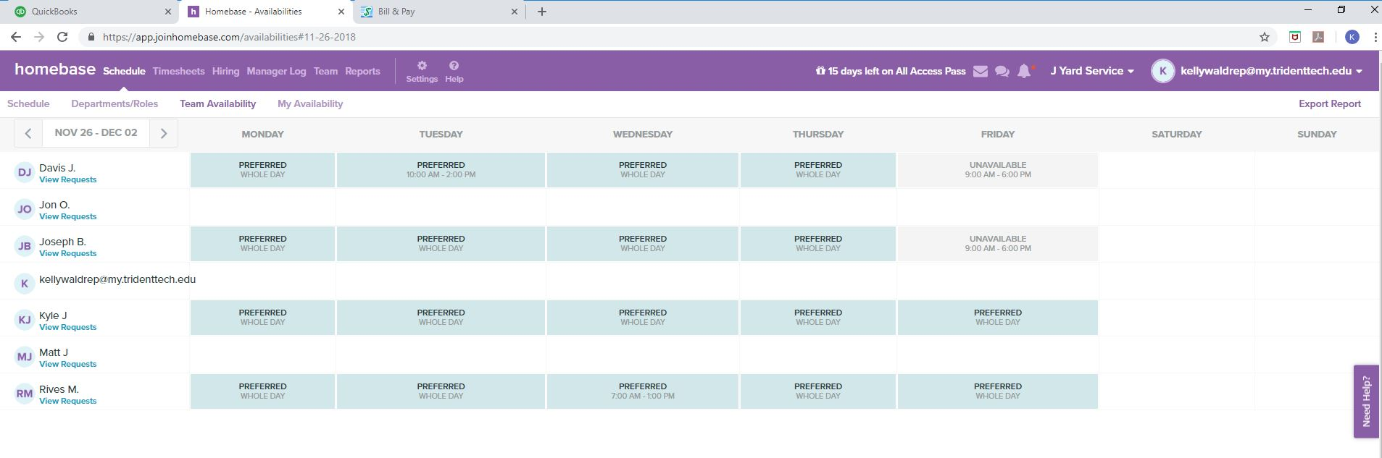
Input Schedule Availability – Homebase Employee Data Synchronized from Quickbooks Online

Slide 25
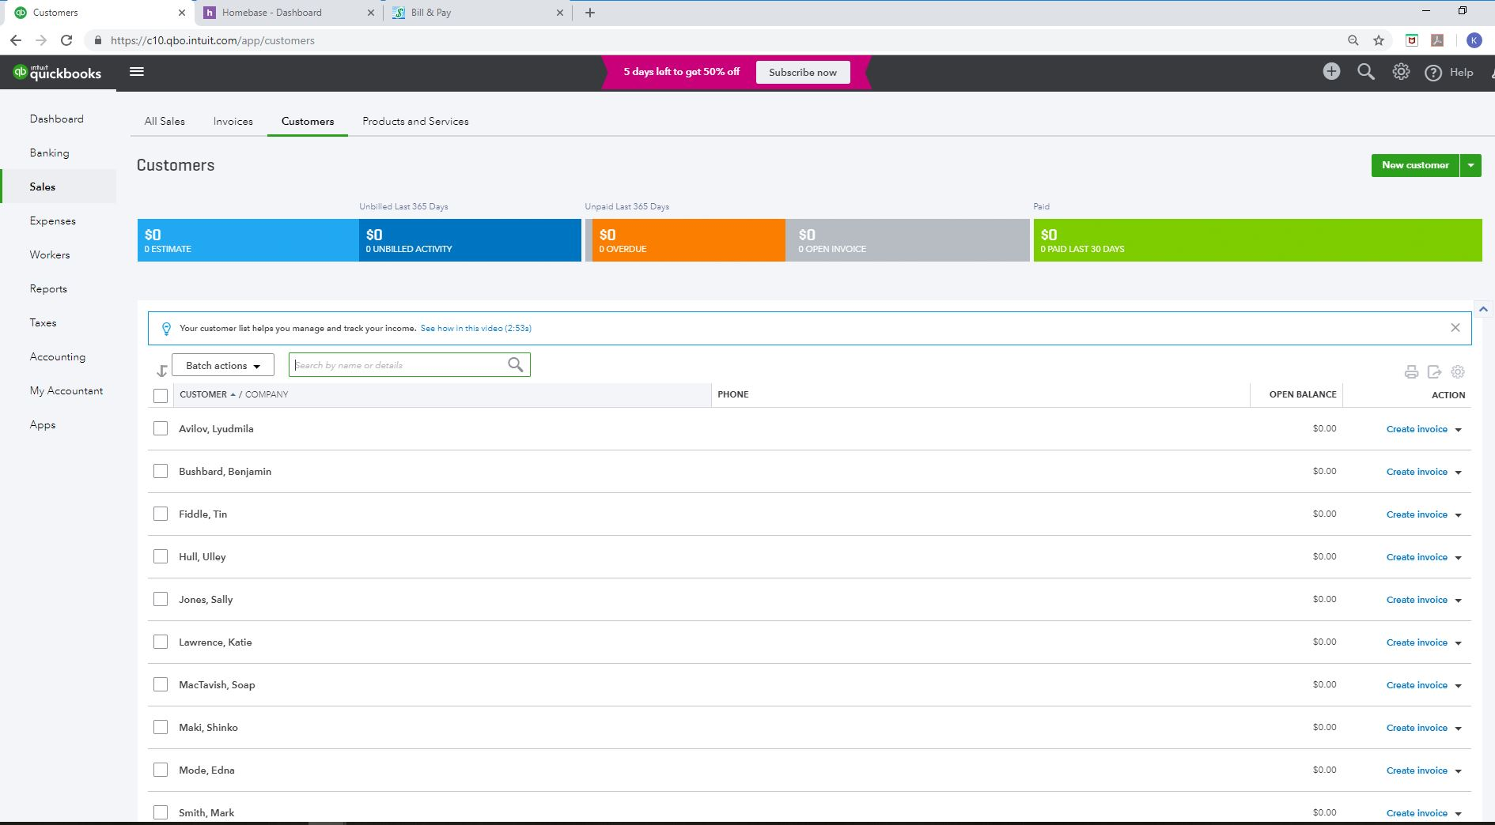
Input Customer Data – Quickbooks Online

Slide 26
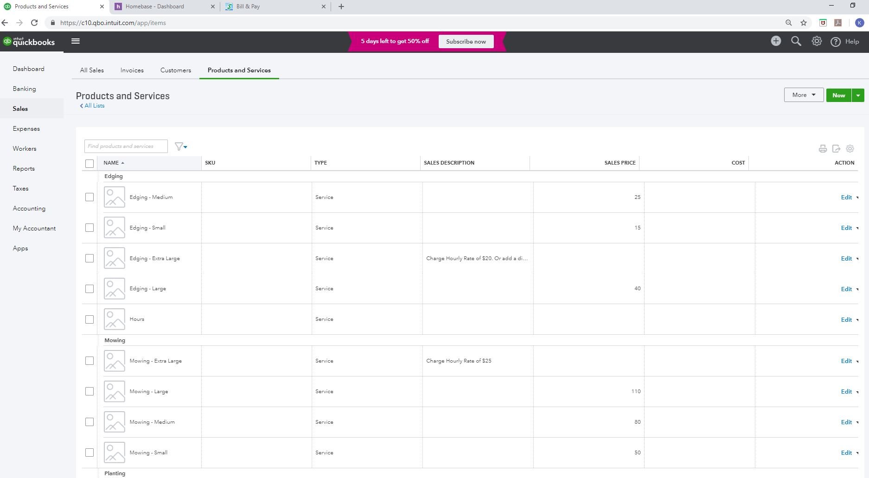
Input Services – Quickbooks Online

Slide 27
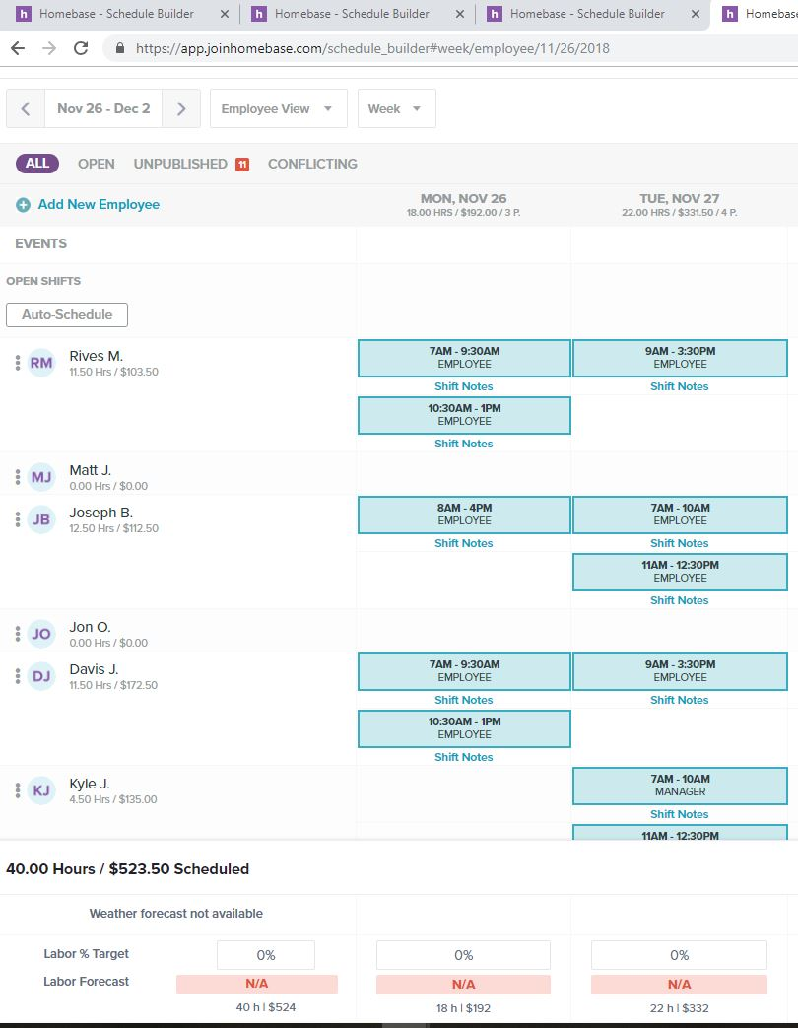
Input Schedule - HOmebase

Slide 28
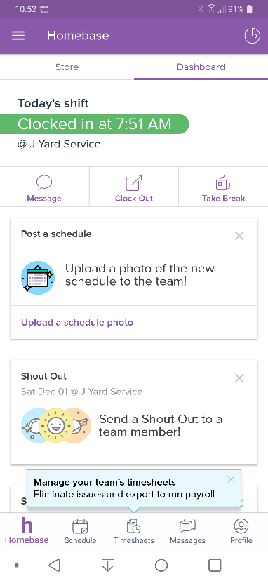
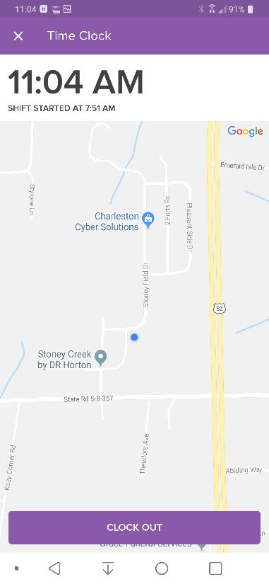
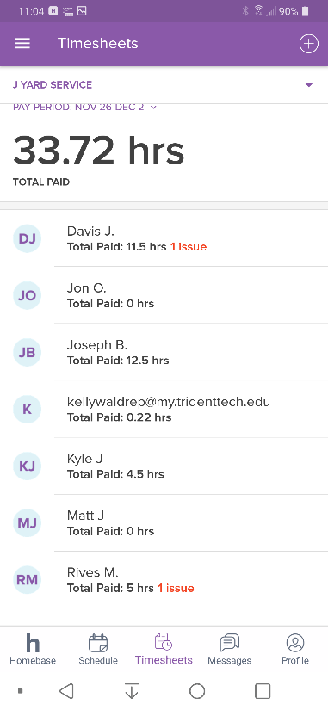
Scheduled Received in Homebase Mobile Application – Clock in/Out Entered into APP GPS Tracks Employee

Slide 29
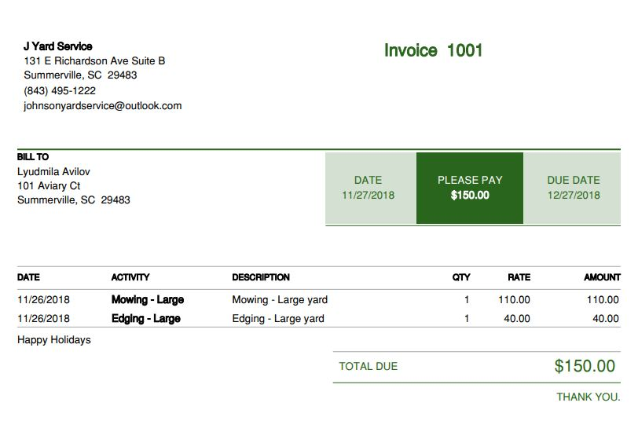
Output Invoice – QuickBooks Online

Slide 30
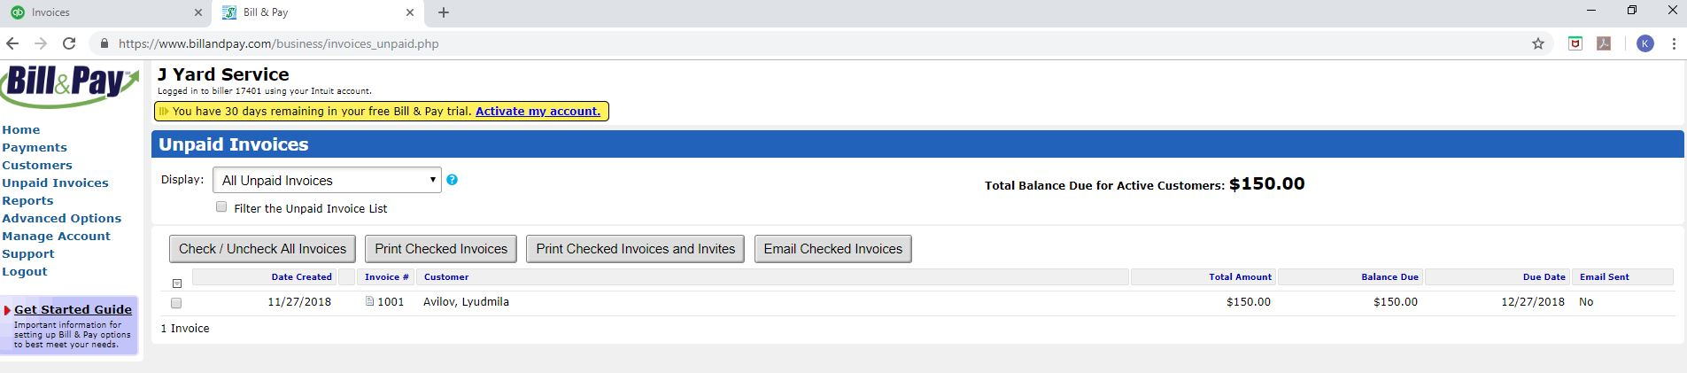
Invoice Information Transfers Automatically to Bill & Pay

Slide 31
Invoice Information Transfers Automatically to Bill & Pay

Slide 32
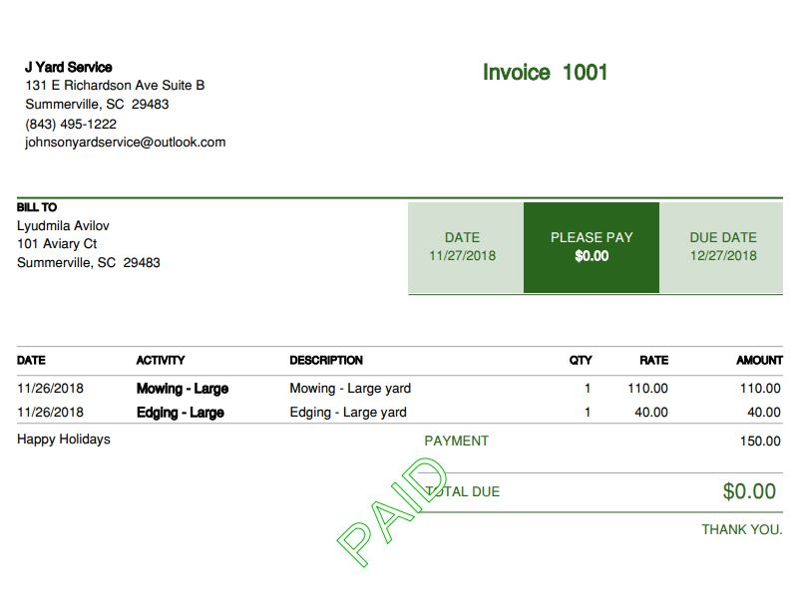
Output Paid Invoice – QuickBooks Online

Slide 33
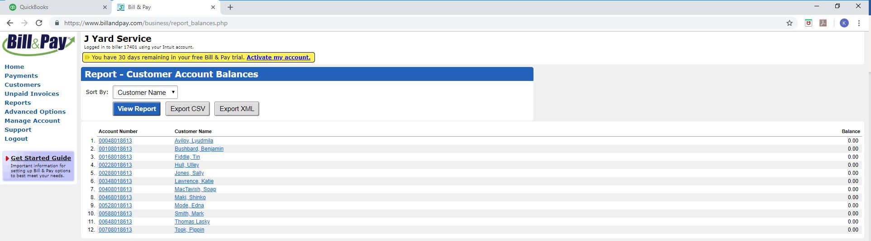
Output Customer Account Balance Report Bill & Pay

Slide 34
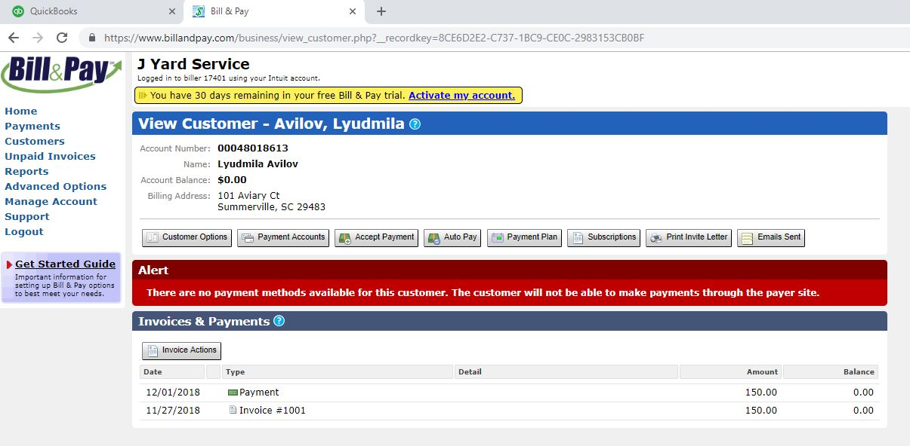
Output Individual Customer Report Bill & Pay

Slide 35
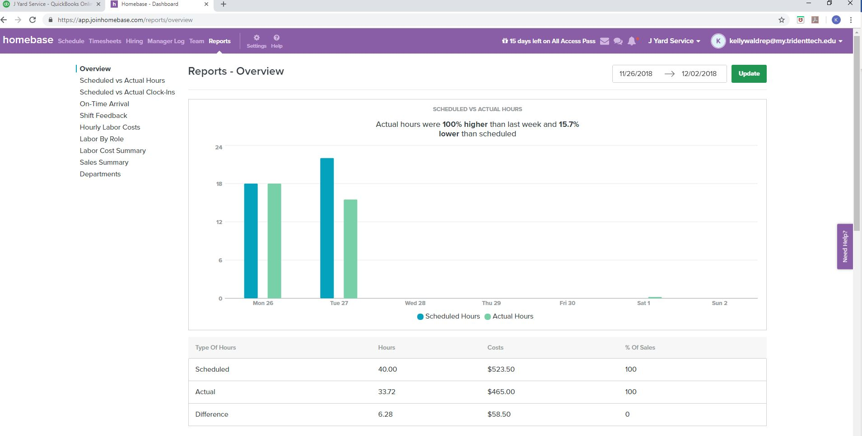
Output Time and Payroll Report Homebase

Slide 36
Alternative Recommendation
Database & Mobile Application Development
Benefits
Custom Design to integrate with Quickbooks Online
Sell application to other landscaping businesses
ROI greater if application marketing is successful
Risks
Mobile application development estimate: $148,500
Source: Development calculator at Mobomo
ROI takes longer and doesn’t exceed investment

Slide 37
Summary
In summary, QuickBooks Online will be used in tandem with Homebase Enterprise as well as Square/Bill & Pay. This will result in:
Automated Tasks
Mobile Platform
Streamlined Communication
Increased Data Integrity
Improved Time Management
Centralized Online Scheduling System
End Goal:
A Fully automated and digitized system to replace manual logs and forms

